Slide 1
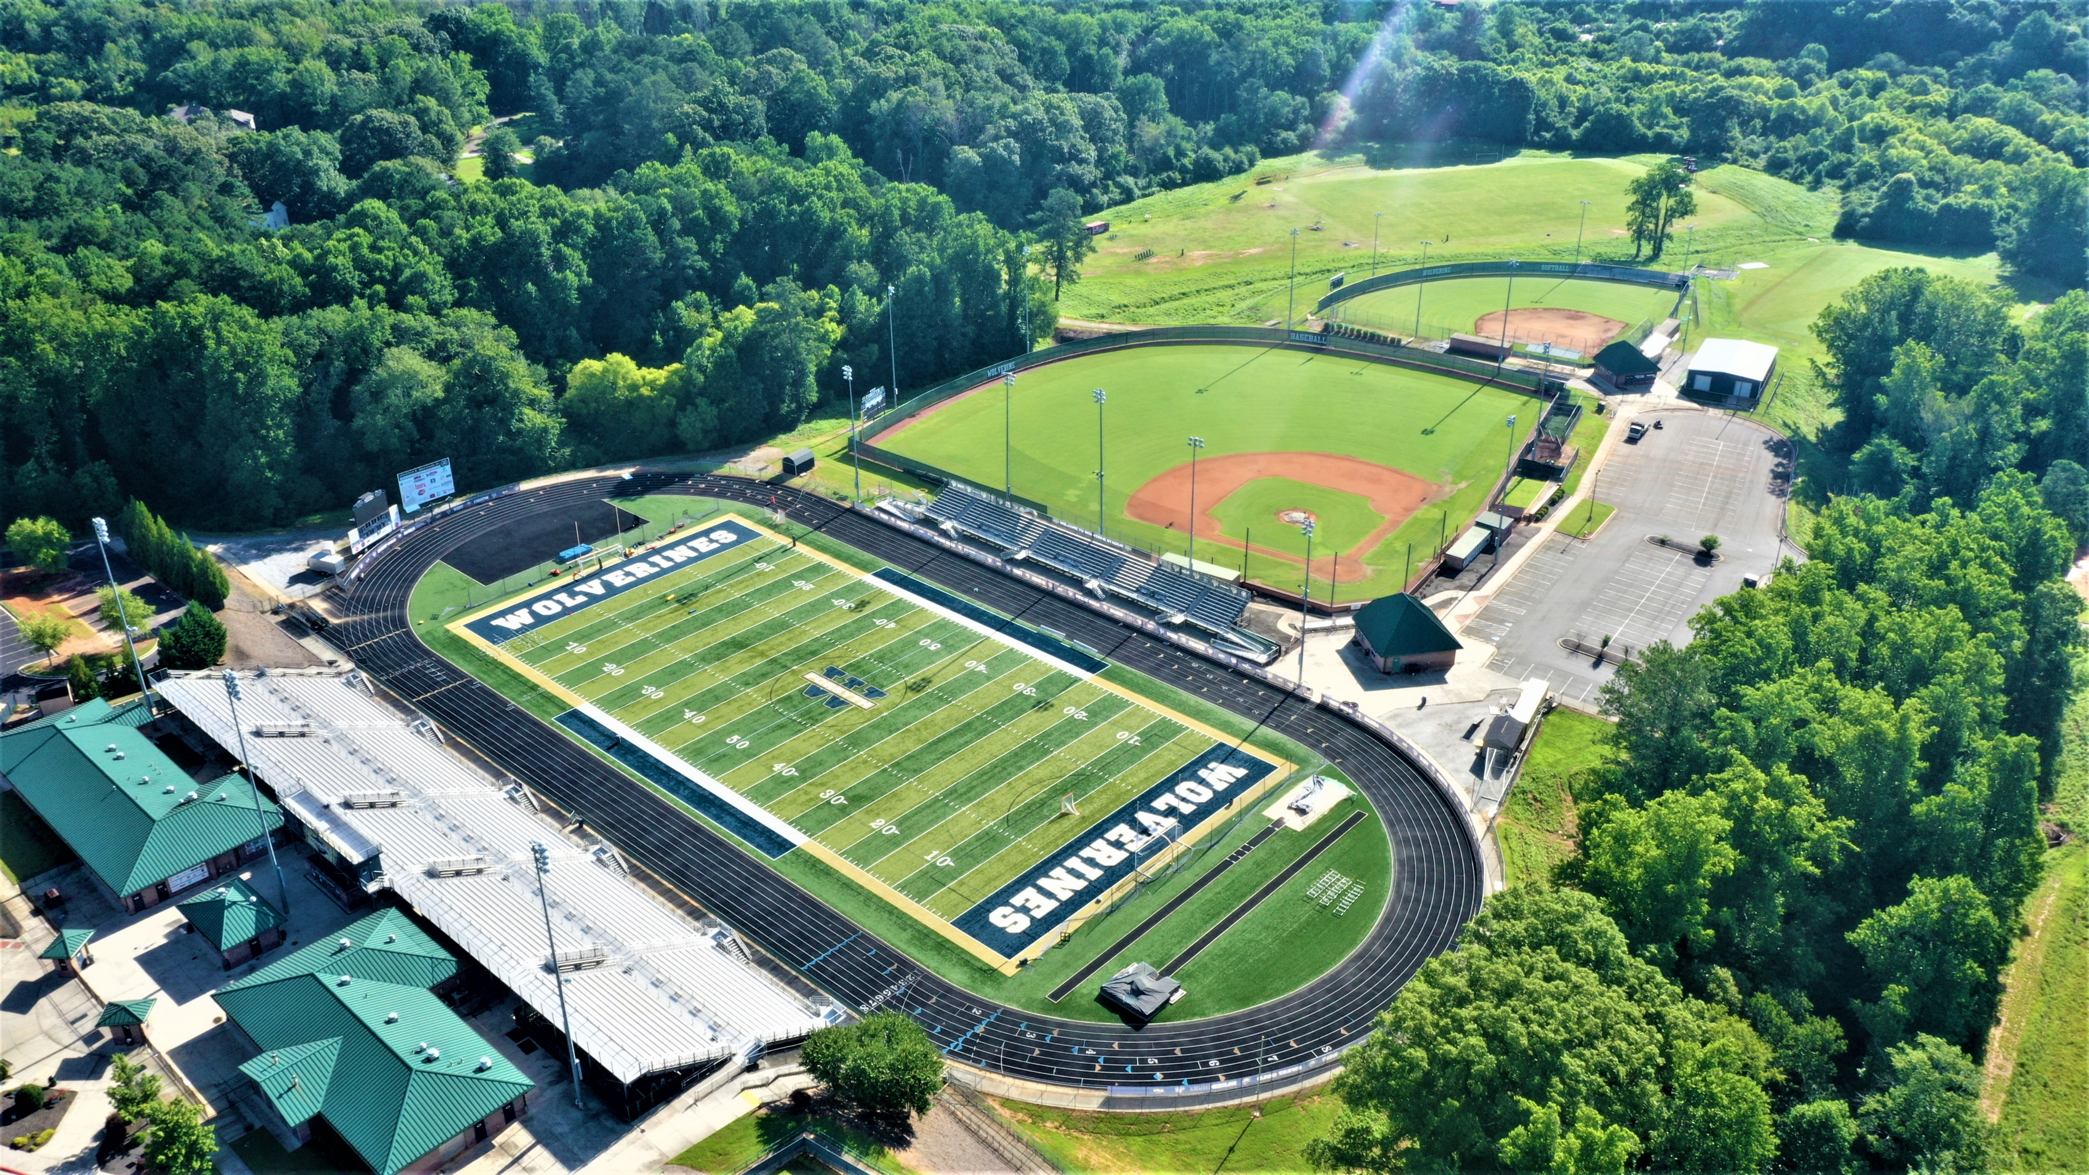
Throws Area
Boys LJ/TJ
Results Board
HJ
Team and tent areas.
Control Tent
Girls LJ/TJ
Team and tent areas.
Timing Tent
PV
Path to team area and field areas.

