Slide 1
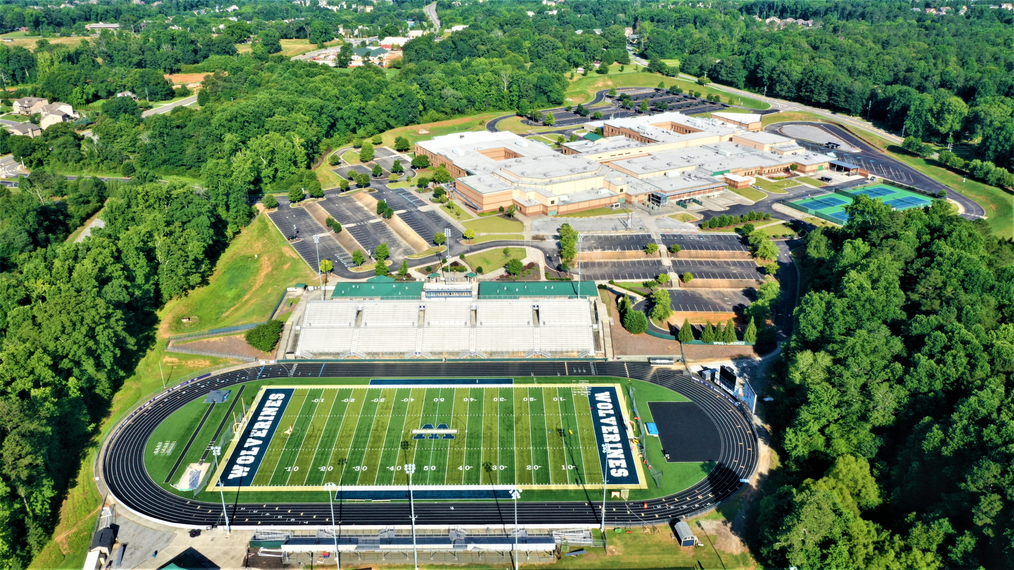
Bus Parking
Kelly Mill Rd.
Drew Rd.
Main Gate
Athlete/Coach Entrance
Bus Dropoff
Team Tent Area
Results Board
Timing
Control Tent
PV
HJ
Girls LJ/TJ
Clerking Tent
Team Tent Area
Team Tent Area
Infield Access
Path to team area on visitor's side!

